Slide 1

Pivot-RP
Custom Branding Guide

Slide 2
How to customize the Pivot-RP UI using the Custom Branding tool
The Pivot-RP customizer/preview tool is highly intuitive.
You can experiment with the tool and use the preview function to get a feel for what is possible without impacting your end-users. Use this guide as a reference.
This document is organized into two overview sections:
  What can be customized
  How to customize and preview Pivot-RP using the custom branding tool
2

Slide 3
What can be customized?

Slide 4
Primary areas that can be customized
These items are all visible on the Home Dashboard Page which all your users see
Add your own logo
Add a custom link that users will go to if they click on your logo
Change the header color and search button color (primary color)
Change the accent colors for the help link and home icon (secondary color)
Add up to two additional custom links in the header
Upload your own background image for the home dashboard page
Modify the content in the right-hand ‘tips & resources’ panel of the home page (which can include text, links, images and HTML styling)
Choose to use the primary or secondary color for limited submission or internal opps highlights
© 2026 Clarivate. All rights reserved.
4

Slide 5
Additional areas that can be customized
Have fun and experiment until you find something that works for you
Add a custom favicon icon to highlight your Internal opportunities
Choose the color (or image) for the background area of the search landing pages for funding, profiles, conferences and awarded grants
Add a custom logo for Weekly Funding Alert emails (optional)
Add a custom logo for Newsletter emails (optional)
Things to keep in mind:
You can choose to configure any (or all) of these features – branding is optional
You can change your mind and modify or update customizations at any time (changes update instantly)
No IT or web design or coding skills are required
You can easily re-set the branding to the Pivot-RP defaults at any time
You can always preview any changes you make before they go live
© 2026 Clarivate. All rights reserved.
5

Slide 6
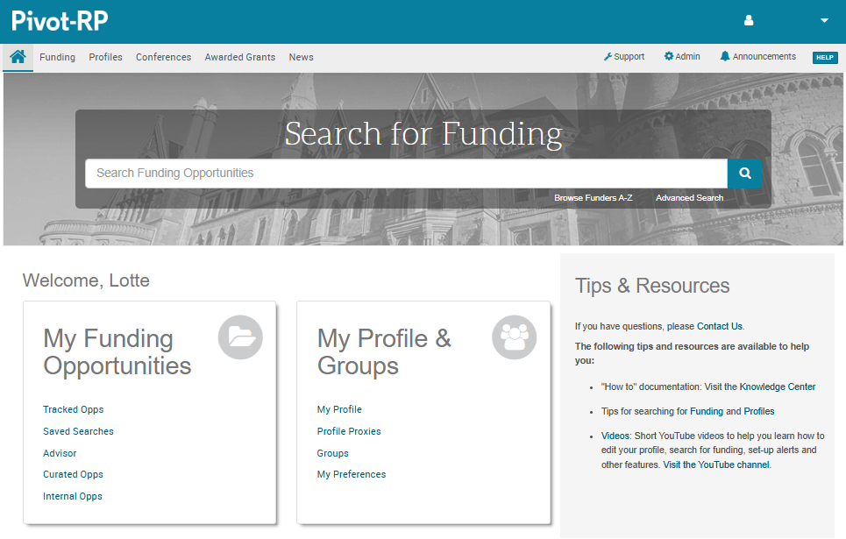
Home Dashboard with default branding

Slide 7
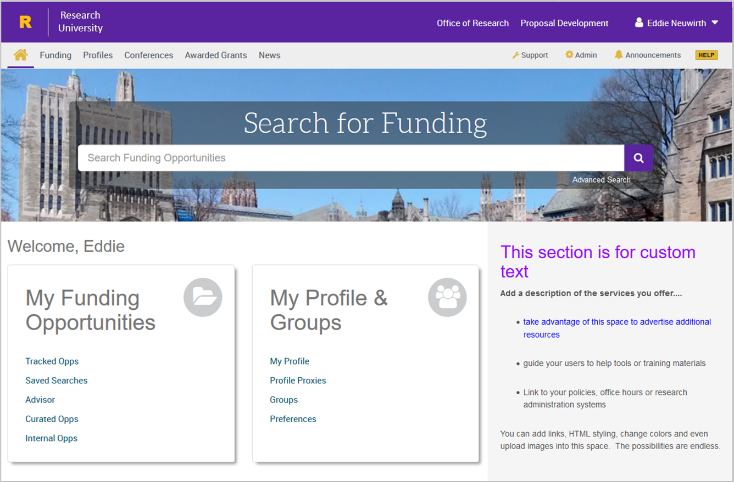
Custom branded example

Slide 8
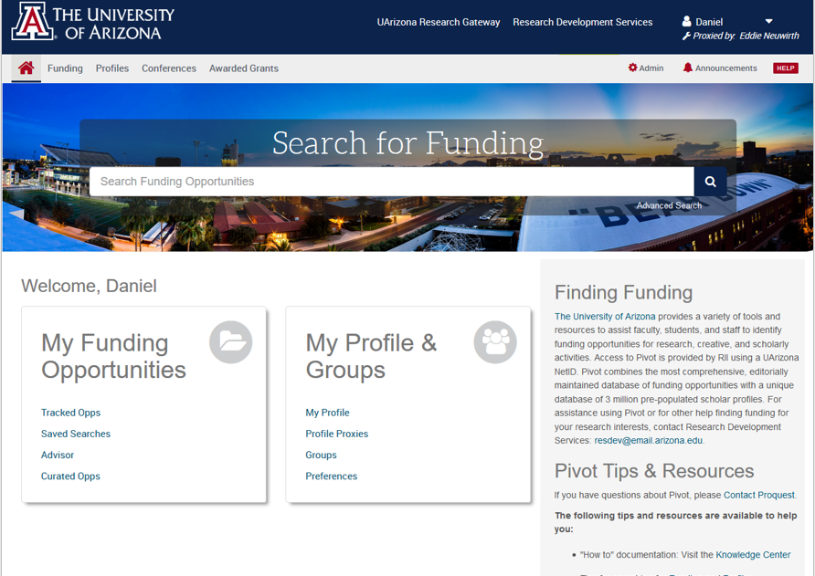
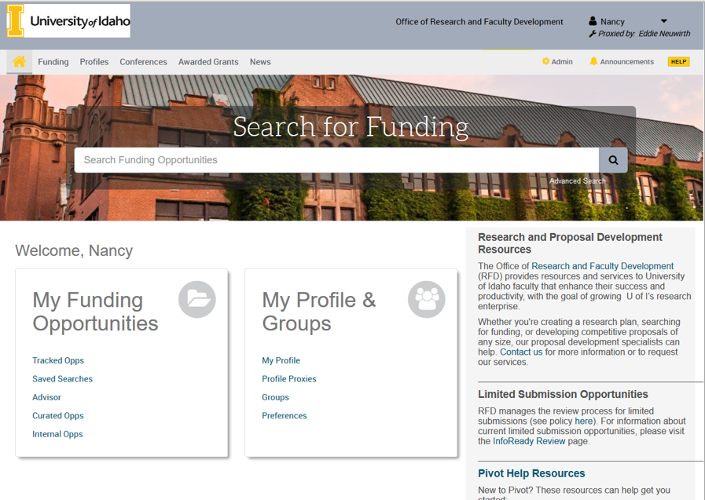
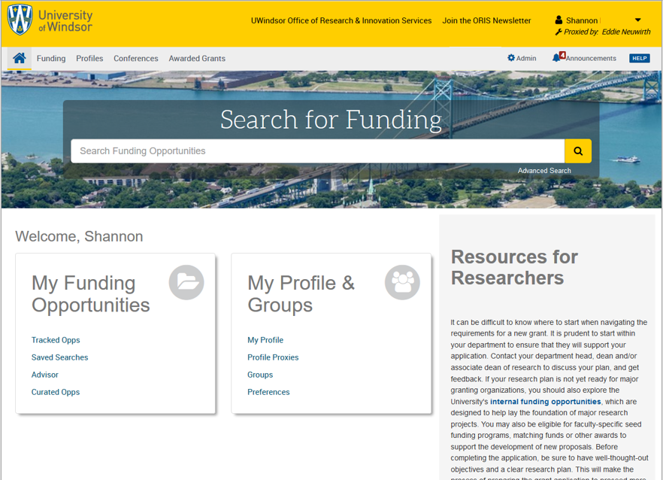
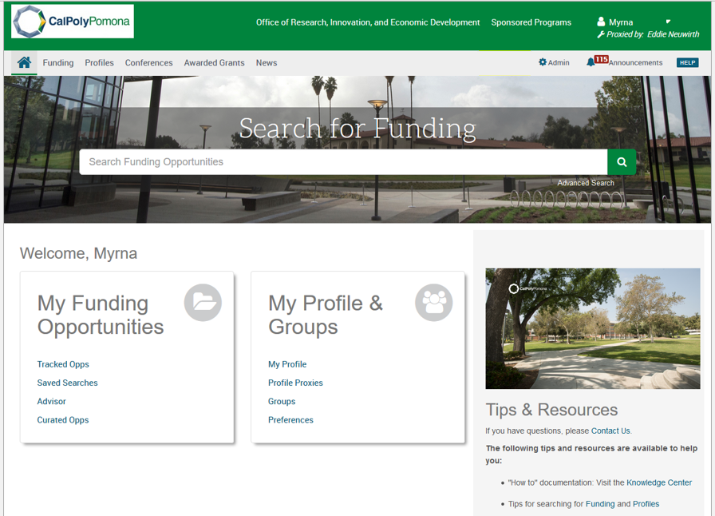
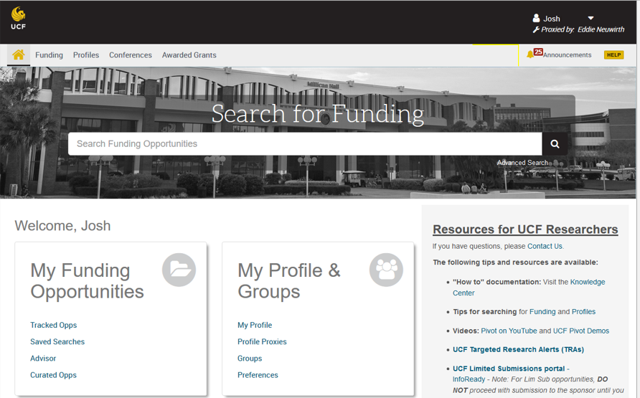
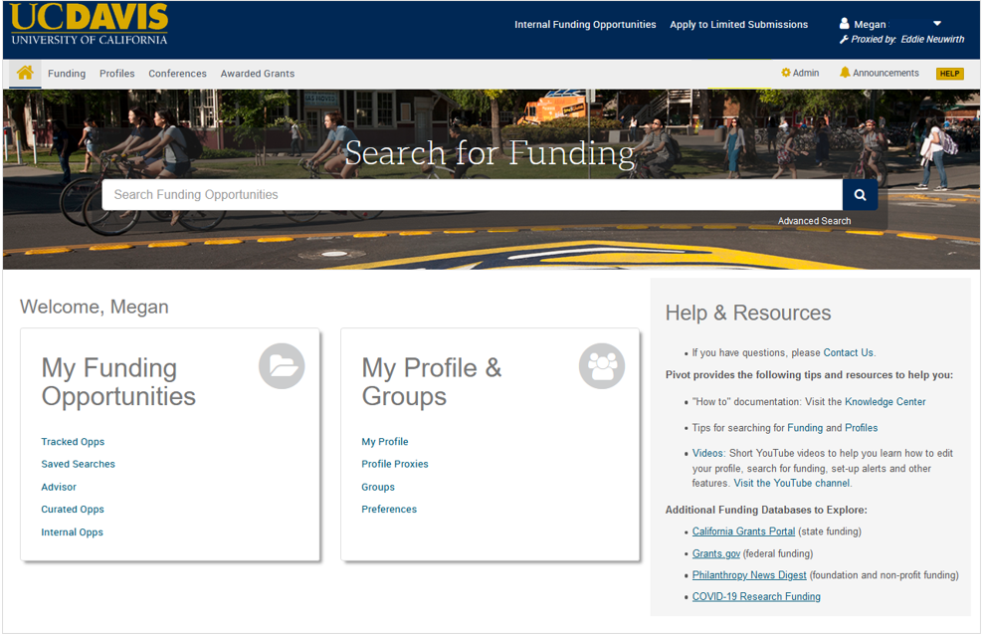
Highly customizable user interface examples
© 2026 Clarivate. All rights reserved.
8

Slide 9
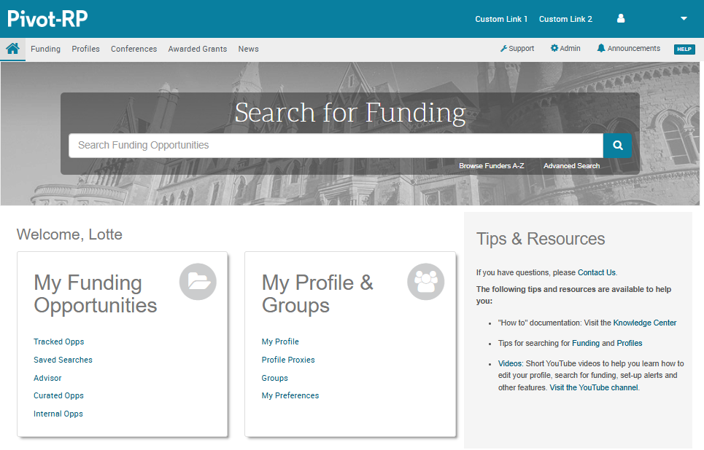
Primary areas that can be customized
Choose a primary header and search button color
Add up to two custom links
Add a custom logo
Choose secondary accent colors
Choose an alternate background image
This section can include custom text, html, links and images; and you can modify the text colors
© 2026 Clarivate. All rights reserved.

Slide 10
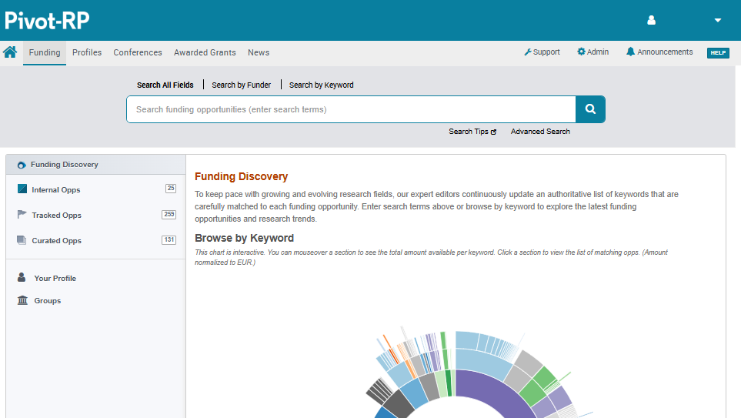
Search page customization
You can choose a search box background color for the primary search pages (Funding Discovery, Profile Discovery, Conferences, and Awarded Grants). The default color is gray.
Load a custom favicon icon to highlight your internal opportunities
(by default this will be a mix of your primary and secondary color choices)
© 2026 Clarivate. All rights reserved.

Slide 11
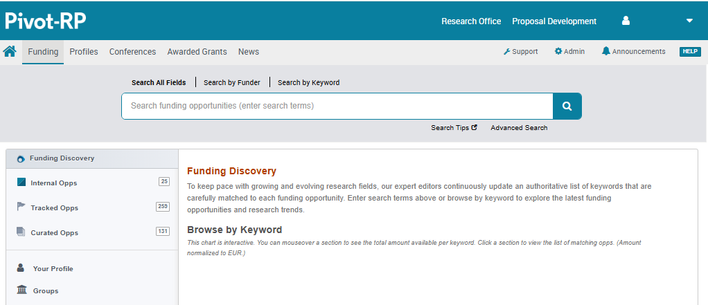
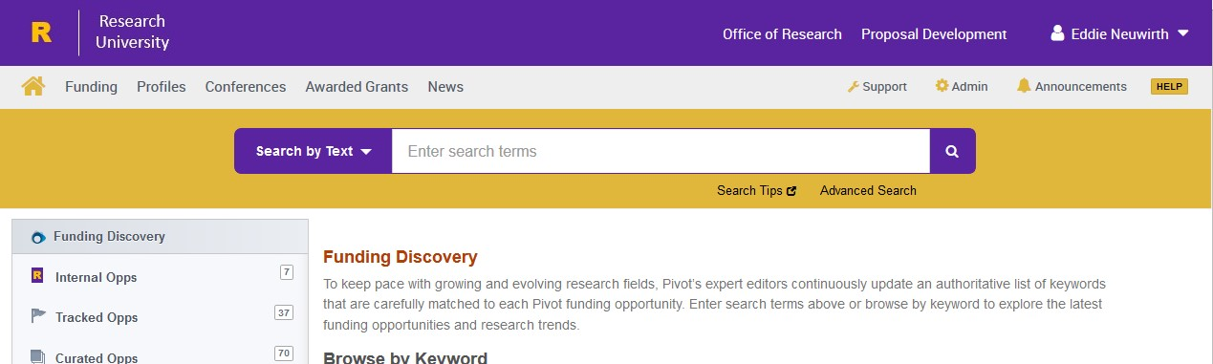
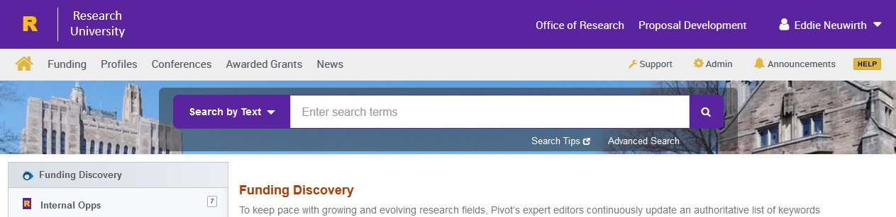
Search page customization
For the search box background color you can choose from the following:
default gray
your secondary color
your home dashboard image
© 2026 Clarivate. All rights reserved.

Slide 12
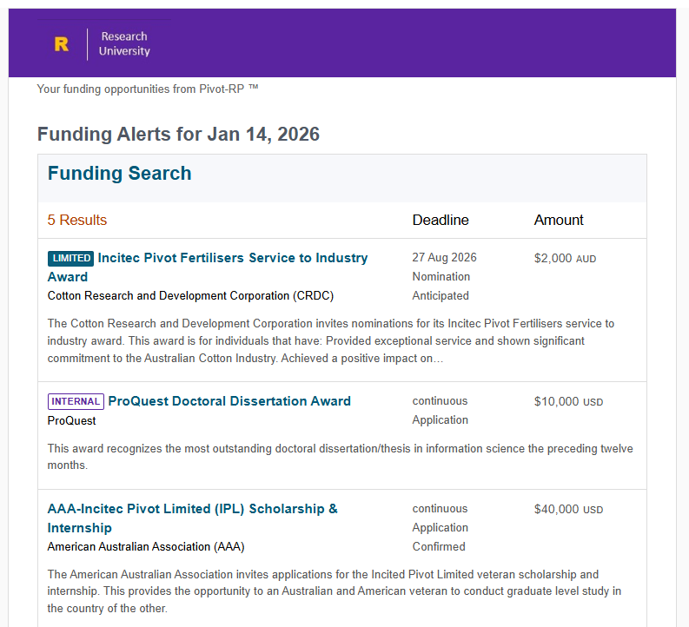
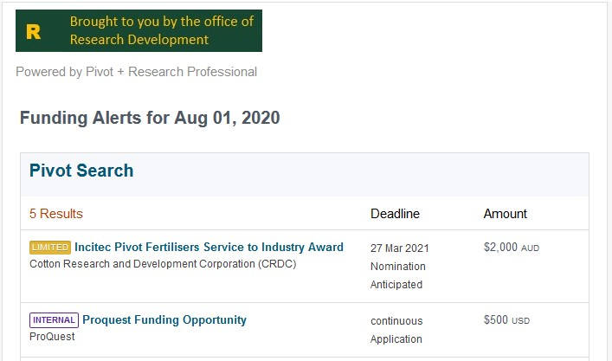

Funding Alert email customization
Custom header/logo
Default header/logo
By default the weekly funding alert emails will use your custom logo and colors from the header branding. If desired, you can replace this with a custom logo.
© 2026 Clarivate. All rights reserved.

Slide 13
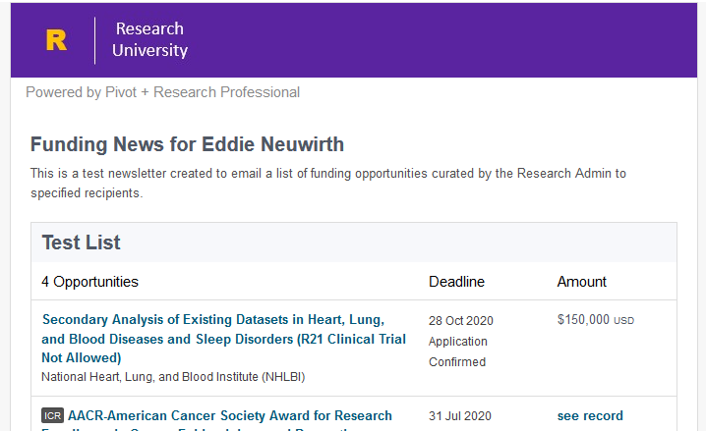
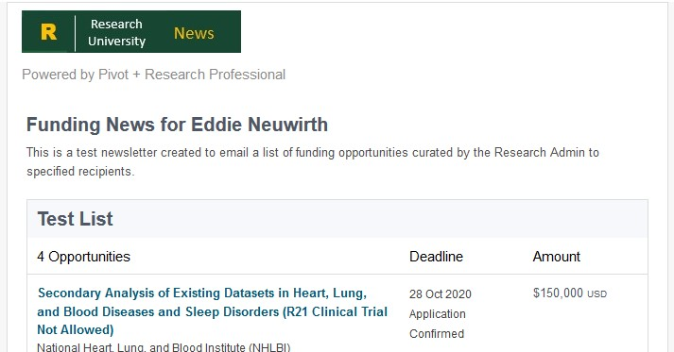
Newsletter email customization
Default header
Custom newsletter header/logo
By default, newsletters will use your custom logo and colors from the header branding. If desired, you can replace this with a custom logo just for newsletters
© 2026 Clarivate. All rights reserved.

Slide 14
How to use the custom branding tool

Slide 15
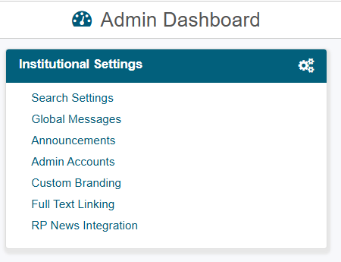
Custom Branding Settings
In the Admin Dashboard → Institutional Settings menu, select Custom Branding to get to the customizer tool
© 2026 Clarivate. All rights reserved.

Slide 16
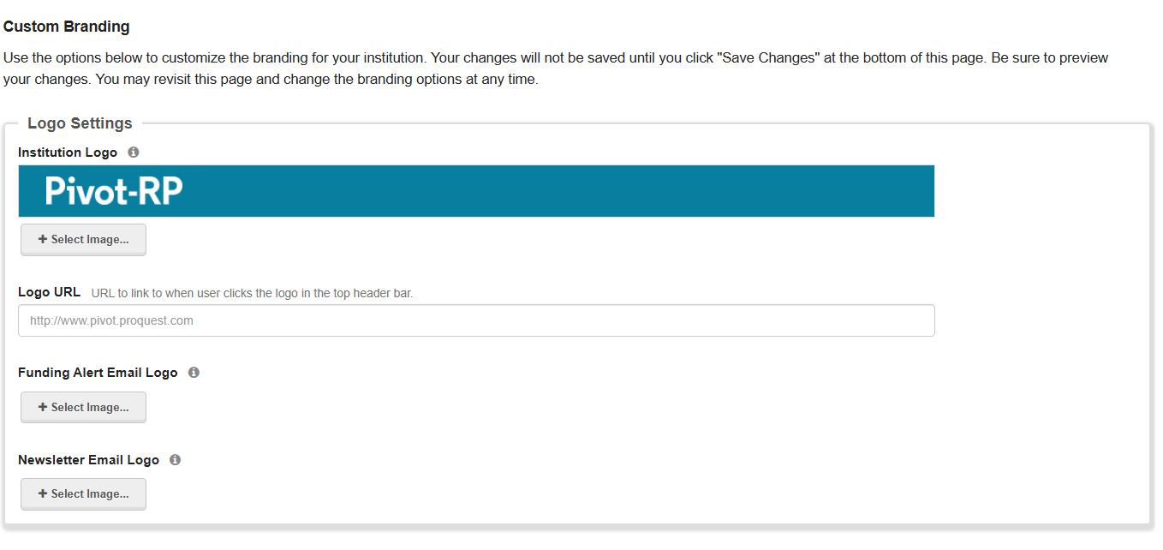
Custom Branding page basics
The branding tool is a single Admin page broken into clear sections with prompts to enter or upload the information needed
An information icon (i) next to each item provides additional detail about where that item appears in the UI and offers size recommendations for images
At the bottom of the page you can “Preview” the customizations that you have made to see what the interface will look like with your selections
If you want to save the changes you’ve made select “Save” otherwise the next time you return to Pivot-RP you will have to start over with the defaults
© 2026 Clarivate. All rights reserved.

Slide 17
Replace the standard Pivot-RP logo with a logo of your choosing
Tips:
The logo is automatically depicted on the primary background color. You may wish to jump to the color settings section first to pick your header color if you want to see what your logo will look like with your color selections.
Try to use a logo that is no more than 80 pixels high. Pivot-RP will automatically re-size logos to fit the header space. A larger logo may not look good.
Add a Logo URL if you want users to be able to link from your logo to another page.
You can also upload different custom logos for Funding Alert and Newsletter emails. You only need to upload a separate logo for Alert and Newsletter emails, if you desire a different look and feel from your header branding. By default, Alerts and Newsletters will use the same logo and colors as the header.
Logo Settings
© 2026 Clarivate. All rights reserved.

Slide 18
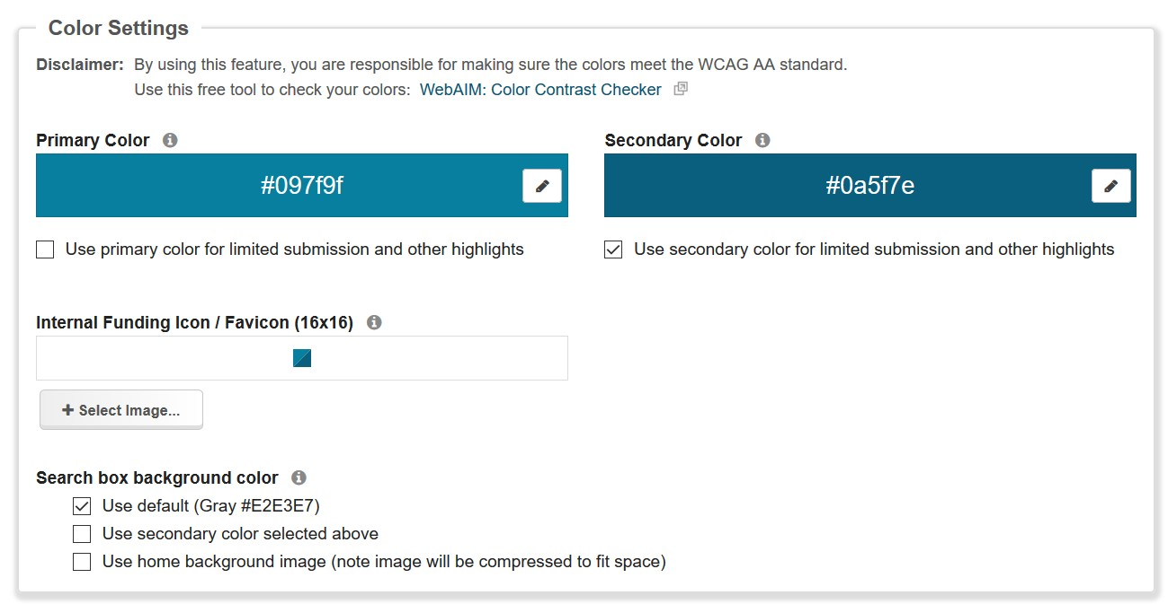
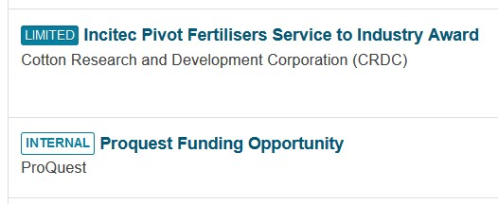
Color Settings
Choose your primary and secondary colors
Primary color is used for the header background color and search buttons
Secondary color can be used for accent colors like the help link, home dashboard icon and limited submission pills
You may also choose whether to use your primary or secondary color to highlight limited submission opportunities
You can also use the secondary color or home background image to fill the search box background area for the search landing pages. By default this area is gray.
© 2026 Clarivate. All rights reserved.

Slide 19
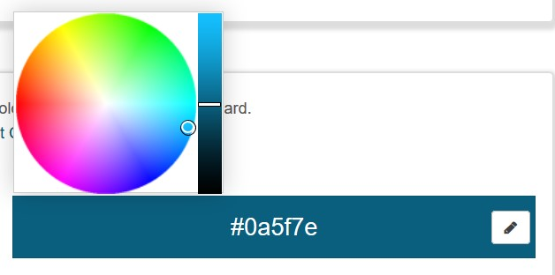

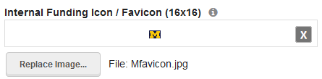
Choosing a Color / Internal Opps Favicon
You can enter a Hexadecimal number directly in the color bar, or select the pencil icon to activate the built-in color picker
The internal funding favicon will by default take on the colors of your primary and secondary color. Or, you can upload your own icon/logo.
© 2026 Clarivate. All rights reserved.

Slide 20

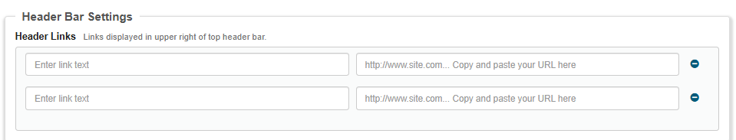
Custom Header Links
You can add up to 2 custom links to your header. Enter the text you want to see on screen in the left input box and provide the URL on the right. You can just leave the custom links fields blank, if you do not want any links to show up on the interface.
Tip: You can use this feature to add some informational text to your header. If you leave the URL field blank, your link text will still show up as text (not as a clickable link)
© 2026 Clarivate. All rights reserved.

Slide 21
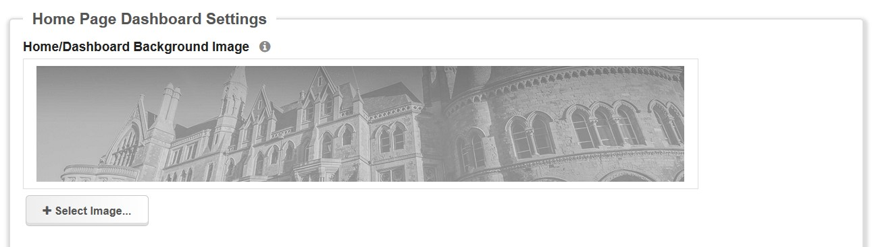
Home Dashboard background image
Replace the default background image with an image of your own choosing. This image can be anything – such as an image of your institution, a nature picture, or an interesting graphic, color or pattern.
Tip: The background image you add will automatically be resized to fit the available space. Try to upload an image around 300px high and 1250px wide if you want it to maintain its original proportions and clarity.
© 2026 Clarivate. All rights reserved.

Slide 22
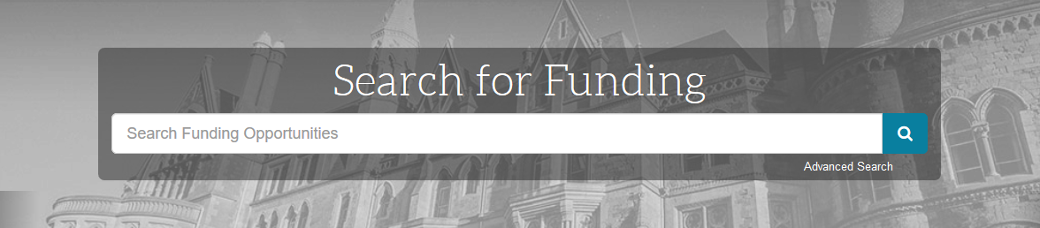
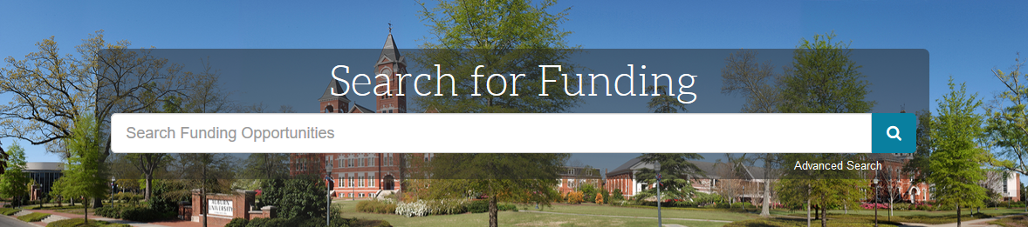
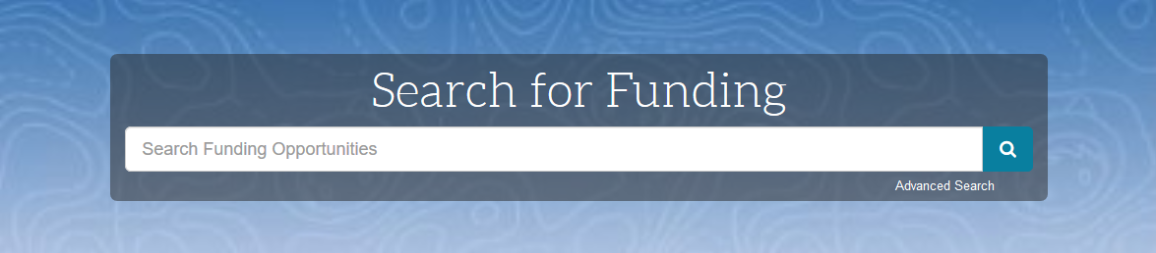
Background image examples & ideas
Default
University
Quad
Pattern

Slide 23
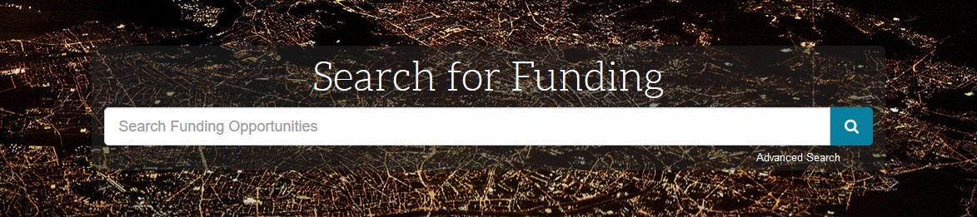
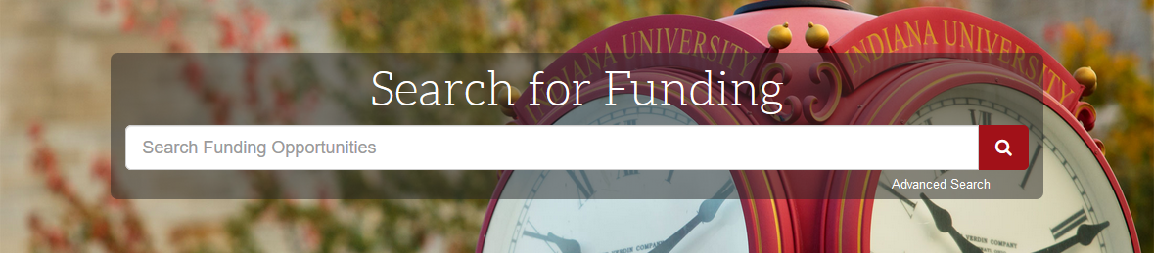
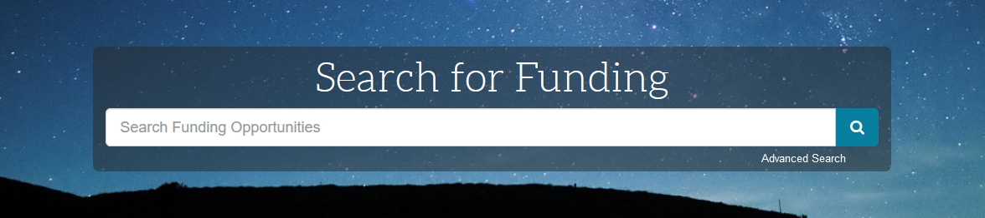
Background image examples & ideas
Technology
University Landmark
Nature

Slide 24
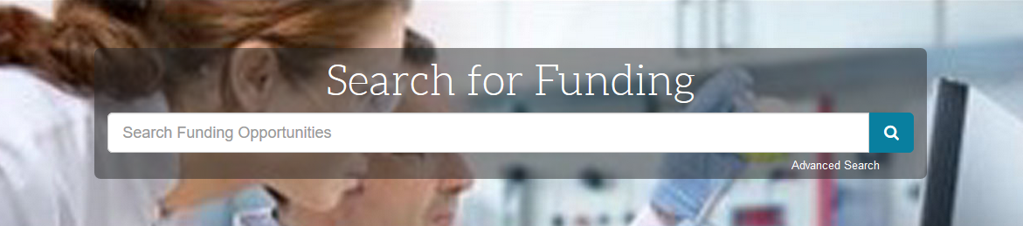
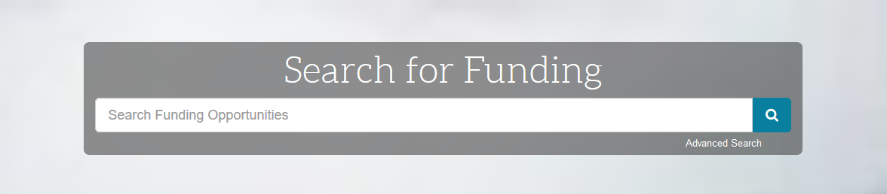
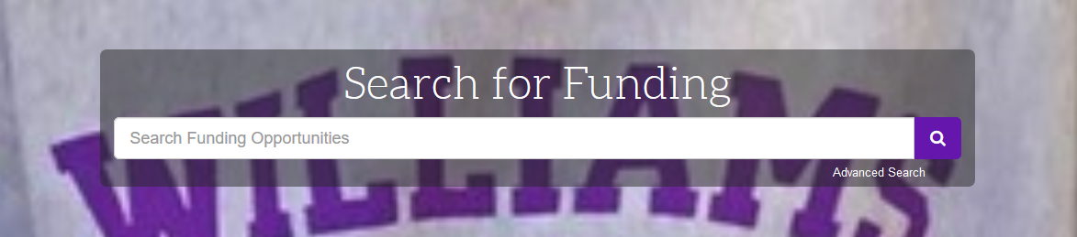
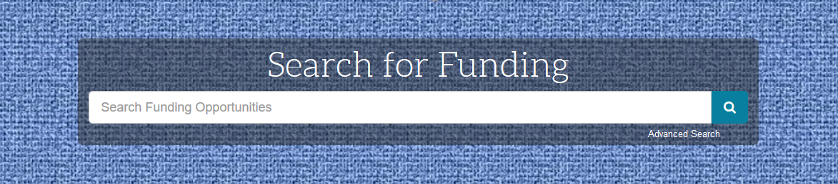
Background image examples & ideas
People
Solid color or gradient
Collegiate logo

Slide 25

Background image sizing and tips
Warning: The background image you add will automatically be resized to fit the available space.
For best result try to upload an image around 300px high and 1250px wide if you want it to maintain its original proportions and clarity.
Any image that is significantly smaller than 1250px wide will be expanded and appear somewhat blurry
Any image that is substantially taller than 300px high will get cut-off and not display fully
Tips: You can add a smaller image with a solid color, gradient color or interesting pattern, if you are looking for a more artistic or blurred background effect.
For example, uploading this tiny image square will give you a solid blue background.
© 2026 Clarivate. All rights reserved.

Slide 26
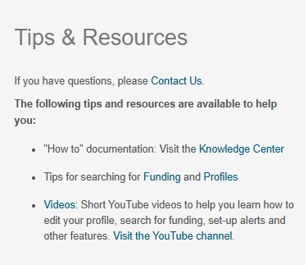
Customizing the right panel
The right-hand column of the Home Dashboard page can be completely customized for your institution.
This area could include:
A description of the services you offer
Important contact information or office hours
Links to important resources, departments, and tools for researchers
Reminders about policies and procedures
A showcase of important research from your institution via links articles, blogs, Twitter, etc.
Special announcements
Links for help, training sessions or user guides on how to use Pivot-RP
And much more…
By default the right panel is pre-populated with links to Pivot-RP help resources. This content can be overwritten using the customizer tool.
© 2026 Clarivate. All rights reserved.

Slide 27
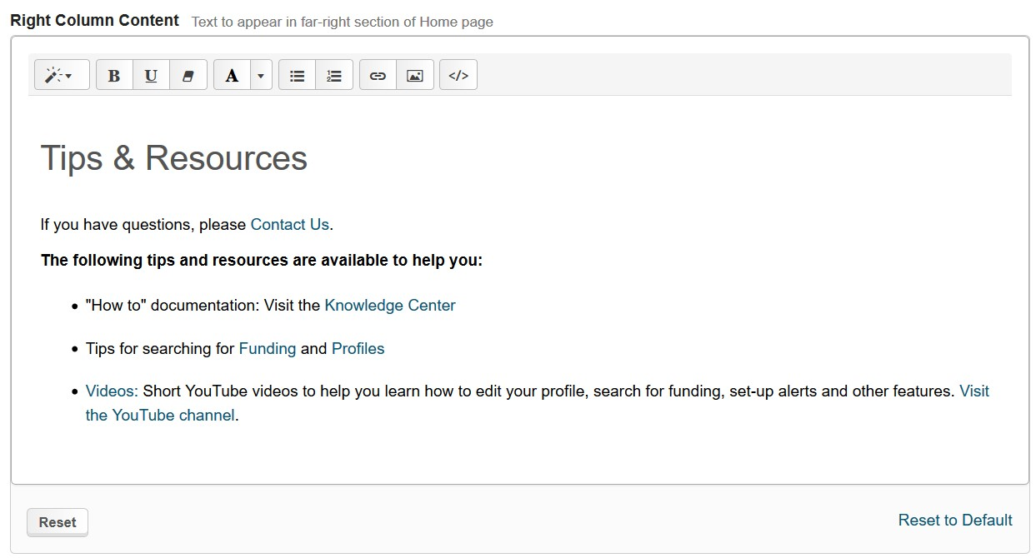
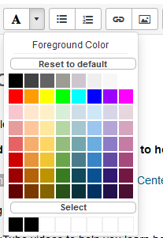
Customizing the right panel: text and colors
Click anywhere in the text area to modify the default text
Use the tools at the top to change the size of text and styling
You can easily change colors of text by selecting the “A” icon to expose the color picker
Hit ‘select’ to create or pick additional colors not visible in the color picker
© 2026 Clarivate. All rights reserved.

Slide 28
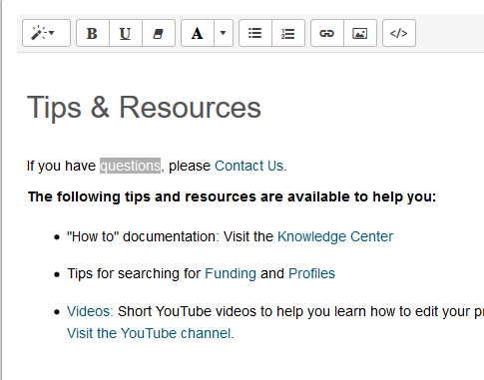
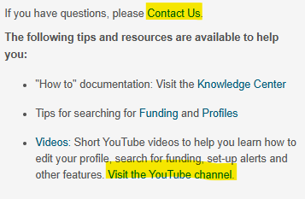
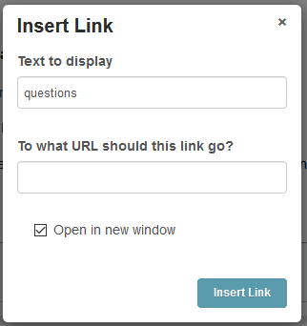
Adding Links
Highlight text that you would like to turn into a link
Select the ‘link’ icon and then enter the URL for the webpage you want this text to link to
You can add unlimited numbers of links to any other webpages or resources.
Tip: You can choose if your link should open in a new browser window/tab (this is recommended)
© 2026 Clarivate. All rights reserved.

Slide 29
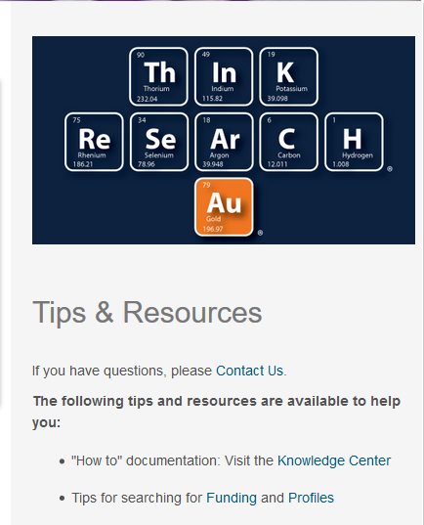
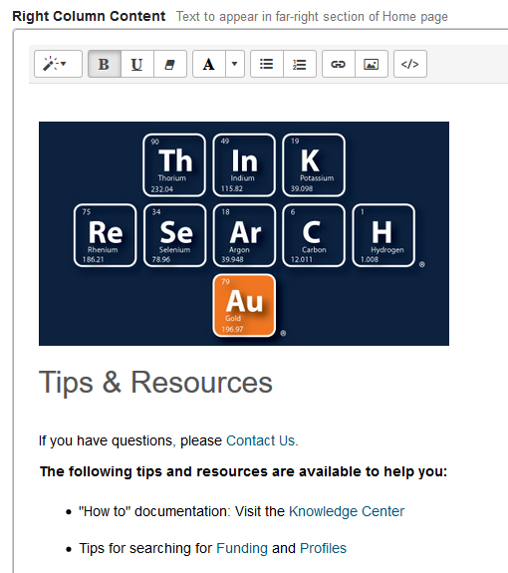
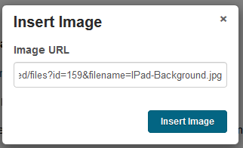
Adding Images
You can easily add images to the right panel
Images must already reside on a published webpage
Select the ‘picture’ icon and then enter the URL path for the image you want displayed
Example of an image showing in right column
Tip: If necessary, you can resize the image. Just click on the image in the console to bring up the re-sizing options tool.
© 2026 Clarivate. All rights reserved.

Slide 30
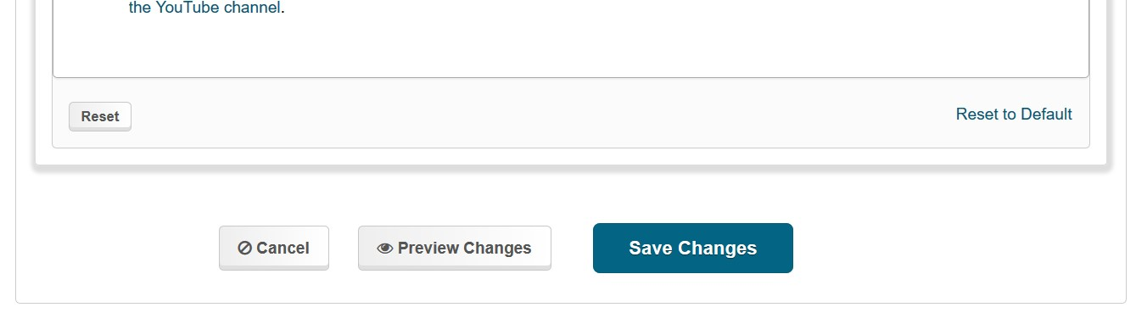
Preview and Save
The most important feature of the customizer tool is the ability to ‘Preview’ and ‘Save’ your customization choices. At the bottom of the page select ‘Preview’ to view what the user interface will look like with the customizations you have made.
Note: No Customization changes will be stored or saved unless you select ‘Save Changes’
© 2026 Clarivate. All rights reserved.

Slide 31
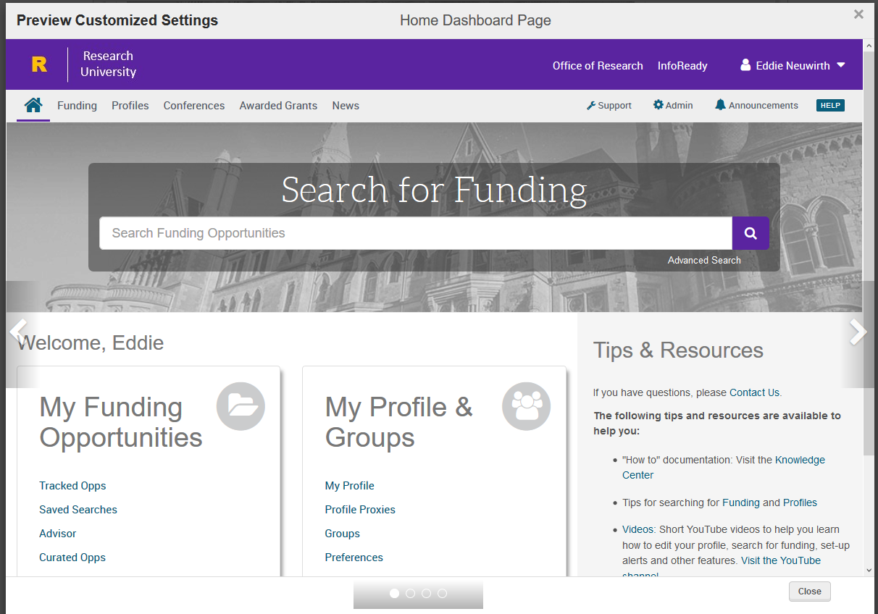
Preview and Save
The preview pane will show you exactly what your customized pages and headers will look like.
Use the console arrows to toggle between the different page views. You can preview:
The home dashboard
Funding Discovery landing page
A funding alert email
A newsletter email
When finished click the “x” or close button to return to the customizer.
Warning: When returning to the customizer tool after previewing - be sure to Save your changes before leaving the customizer or none of your customizations will be saved for the next time you return to the custom branding tab.
© 2026 Clarivate. All rights reserved.

Slide 32
Save Your Changes
Warning: If you do not ‘Save Changes’ before leaving the customizer tool you will lose any customizations that you have made during your current session and you will need to start over with customizing when you return.
  Pivot-RP does not store any of your changes unless you select ‘Save Changes’.
  Previewing Changes does not do anything to save changes.
Need Additional Help? Contact Support
https://support.proquest.com/s/pivot?language=en_US
© 2026 Clarivate. All rights reserved.

